Slide 1
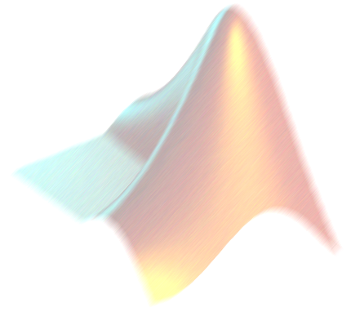
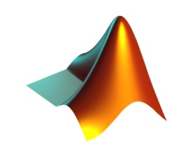
Introduction to Numerical Solutions of Differential Equations
AM2032 JAYANTA MUKHERJEE

Slide 2
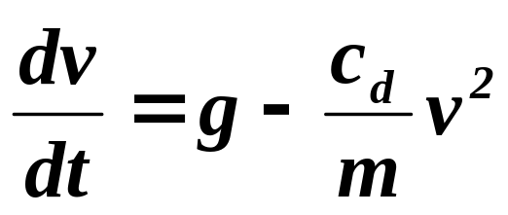
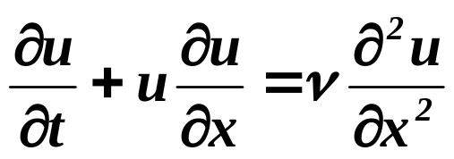
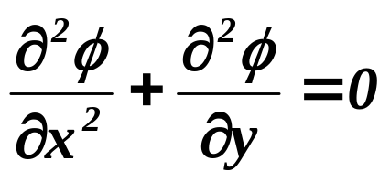
Differential Equations
There are ordinary differential equations - functions of one variable
And there are partial differential equations - functions of multiple variables

Slide 3

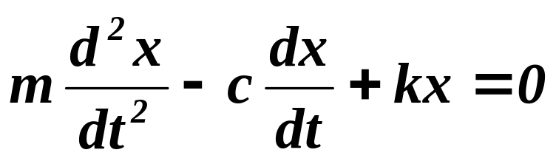
Order of Differential Equations
1st order (falling parachutist)
2nd order (mass-spring system with damping)
etc.

Slide 4
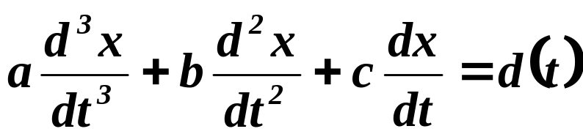
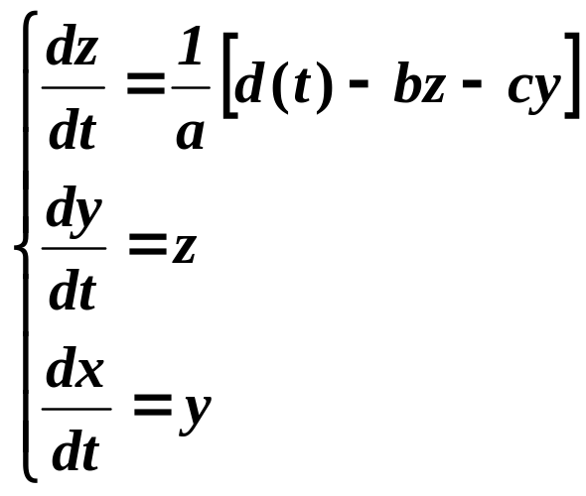
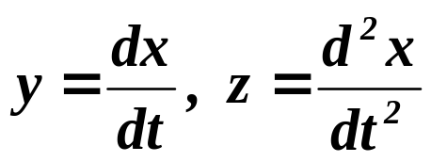
Higher Order ODE’s
Can always turn a higher order ODE into a set of 1st order ODE’s
Example:
Let then
So solutions to first-order ODEs are important

Slide 5
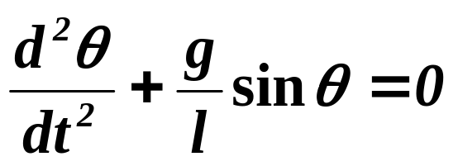
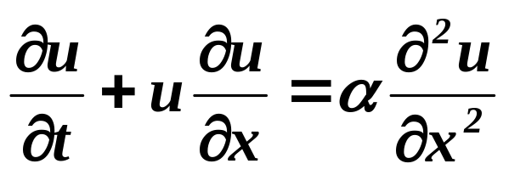
Linear and Non-Linear ODE’s
Linear: No multiplicative mixing of dependent variables, no nonlinear functions
Nonlinear: anything else

Slide 6
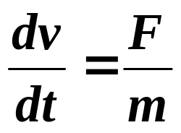
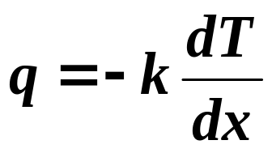
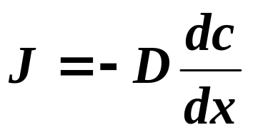
ODE’s
ODE’s show up everywhere in engineering:
Dynamics (Newton’s 2nd law)
Heat conduction (Fourier’s law)
Diffusion (Fick’s law)

Slide 7
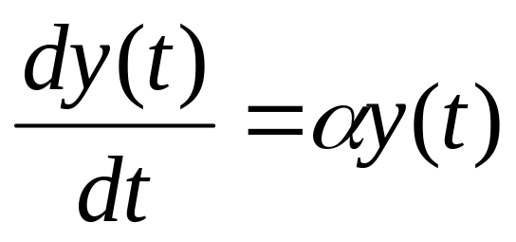
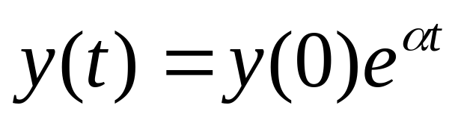
So…….What is an ODE?
Ordinary Differential Equations
First order ODE’s relate the first derivative
of a function (say, time rate of change) with the function itself. The ODE is first order if only the first derivative of the function is included.
Exponential growth or decay is governed
by this simple ODE. Plug in y(t) to check.

Slide 8
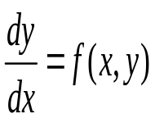
Ordinary Differential Equations
How does an equation of form arise?
How do we use it?
Consider the following:

Slide 9


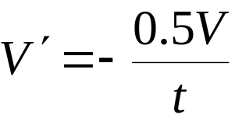



How does a Differential Equation Arise?
Water flows out of the bottom of a tank of muddy water through a small tap at a rate proportional to the volume.
(The more water in the tank the faster the flow.) However, with time, the tap slowly clogs up and so the rate of flow of water is inversely proportional to time.
Experiment gives
The tap is turned on at midnight and by 10AM the tank holds 24000 litres. How much water is left in the tank at 3pm?
Notice we need some starting information
We want to find V(15) i.e. at 3pm

Slide 10
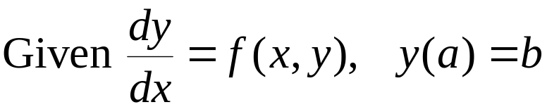

Initial Value Problem
Notice the problem can be abstractly stated as:
Given
and V(10) = 24000
Find V(15)
The general form of equations we will consider is

Slide 11
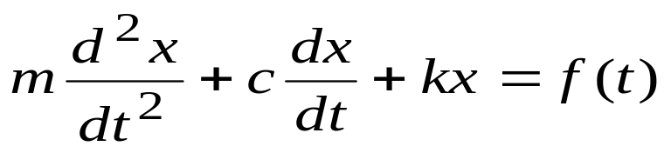
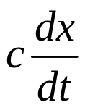
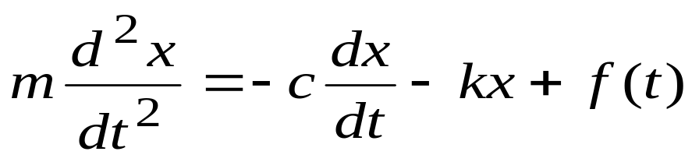
Another Example
x
k
f(t)
What order is this ODE?
If f(t) = 0, ODE is homogenous.
If f(t) is not equal to 0,
ODE is non-homogenous.
m
c
Free-body
diagram
kx
f(t)
m

Slide 12
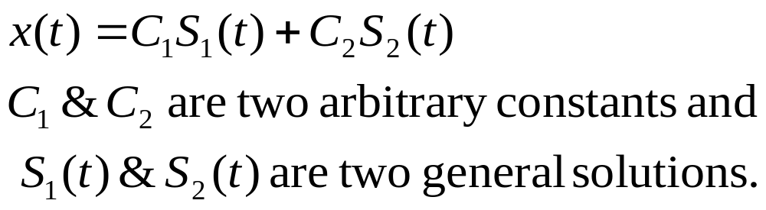
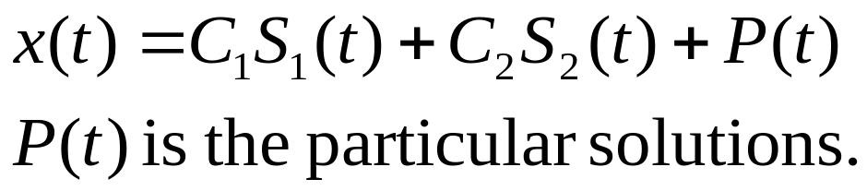
Solutions of ODE’s
The solution for the homogenous ODE.
The solution for the non-homogenous ODE
The arbitrary constants C₁ & C₂ are determined by the Initial-
value or Boundary-value conditions.

Slide 13
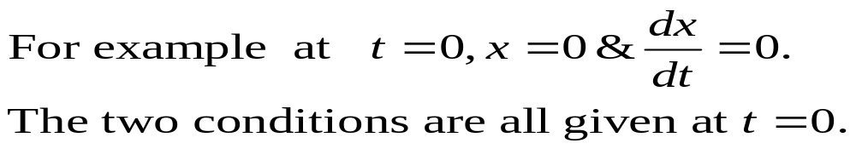
Initial and Boundary Value Conditions
The I-V Conditions → All conditions are given
at the same value of the independent variable.
The B-V Conditions → Conditions are given
at the different values of the independent variable.
The numerical schemes for solving Initial-value and boundary-value are different.

Slide 14
Numerical Solutions of ODE’s
Initial Value Problems
Euler’s and Heun's methods
Runge-Kutta methods
Adaptive Runge-Kutta
Multistep methods
Adams-Bashforth-Moulton methods
We are going to look at these

Slide 15
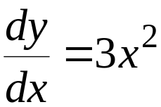

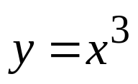
A Specific Example
Consider the differential equation with
How can we find y(2)?
This is a simple equation which we can integrate to get
So y(2) = 8
What if the expression was too complicated to integrate,
but we still needed to find y(2)?
In this case a numerical method is needed. There are a number of such methods. We will be considering one called Euler’s method.

Slide 16
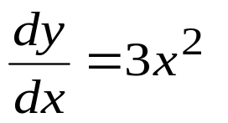
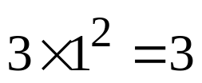
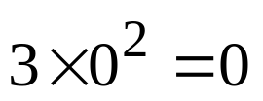
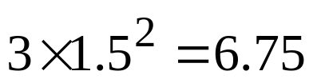
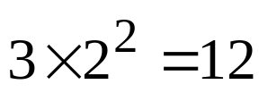
Euler’s Method-1
Again consider
8
This allows us to calculate a gradient at any point (x,y)
7
→ Here the gradient depends only on x
6
At
(1,2)
Gradient:
5
(0,4)
4
(1.5,1)
3
(1.5,5)
2
(2,7)
1
0
0
1
2

Slide 17
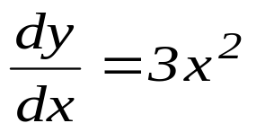

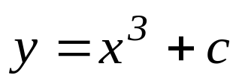

Euler’s Method-2
Continuing on with we obtain the
gradient at each point.
8
The graph now allows us to visualize a set of solution curves, , that start on the y axis and follow a flow of the dashes.
7
6
5
In fact, we know that this curve is
by integrating
4
3
Euler’s method works by approximating
the curve by a series of straight line segments
2
1
0
0
1
2

Slide 18
Euler’s Method-3
8
Start at x Gradient
7
0
0
6
0.5
0.75
5
1
3
4
1.5
6.75
3
Our estimate of y(2) is 5.25 which is not too good.
2
1
0
0
1
2

Slide 19
Euler’s Method-4
Repeat with smaller steps
8
7
Start at x Gradient
0
0
6
0.25
0.2
0.5
0.8
5
0.75
1.7
1
3
4
1.25
4.7
1.5
6.8
3
1.75
9.2
2
Our estimate of y(2) is 6.6 which is improving.
1
0
0
1
2

Slide 20

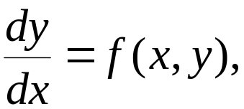


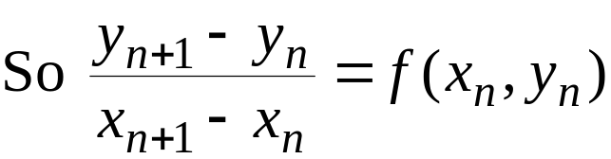



Euler’s Method-5
Assume we have already applied the method and have joined up the points
Since
If the steps along the x-axis are kept fixed at h, this gives the formulae which tell how to get from one point to the next

Slide 21
Euler’s Method-6
Procedure
Start from the given point
Calculate the next point using
Continue
Notice each time you continue the calculated point becomes the new starting point.

Slide 22
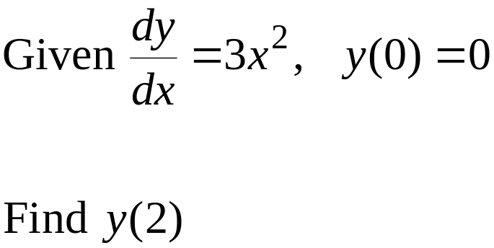
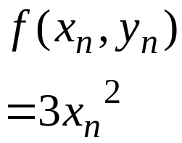
Euler’s Method-7
using a step size of h = 0.5
x
y
y
=
y
+
hf
(
x
,
y
)
n
n
n
+
1
n
n
n
0
0
0
0+0.5×0 = 0
0.5
0
0.75
0+0.5×0.75 = 0.375
1
0.375
3
0.375+0.5×3 = 1.875
1.5
1.875
6.75
1.875+0.5×6.75 = 5.25
2
5.25

Slide 23
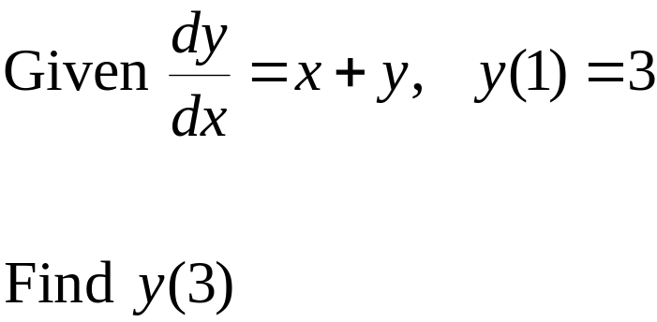

Euler’s Method-8
Another Example:
Use a step size of h = 1
x
y
y
=
y
+
hf
(
x
,
y
)
n
n
n
+
1
n
n
n
1
3
4
3+1×4 = 7
2
7
9
7+1×9 = 16
3
16

Slide 24
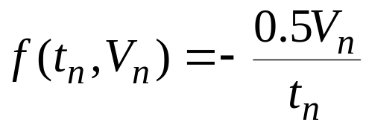



Euler’s Method-9
Back to the original problem:
Given
and V(10) = 24000
Find V(15) using a step size of h = 1
10
24000
-1200
22800
11
22800
-1036
21764
12
21764
-907
20857
13
20857
-802
20055
14
20055
-716
19399
15
19399

Slide 25


Euler’s Method-10
A non clogging tap is fitted to the tank. Solve:
Given
and V(10) = 24000
Find V(15) using a step size of h = 1
10
24000
-12000
12000
11
12000
-6000
6000
12
6000
-3000
3000
13
3000
-1500
1500
14
1500
-750
750
15
750

Slide 26
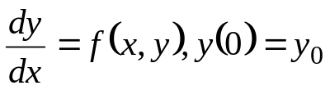
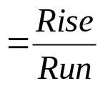
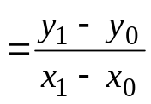



Graphical Interpretation of the Euler’s Method
y
Slope
True value
y₁, Predicted
value
x₀,y₀
Φ
Step size, h
x

Slide 27


Graphical Interpretation of the Euler’s Method-cont.
y
True Value
y_{i+1}, Predicted value
y_{i}
Φ
h
Step size
x_{i}
x_{i+1}
x

Slide 28
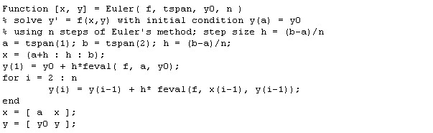
Matlab Function for Euler’s Method

Slide 29
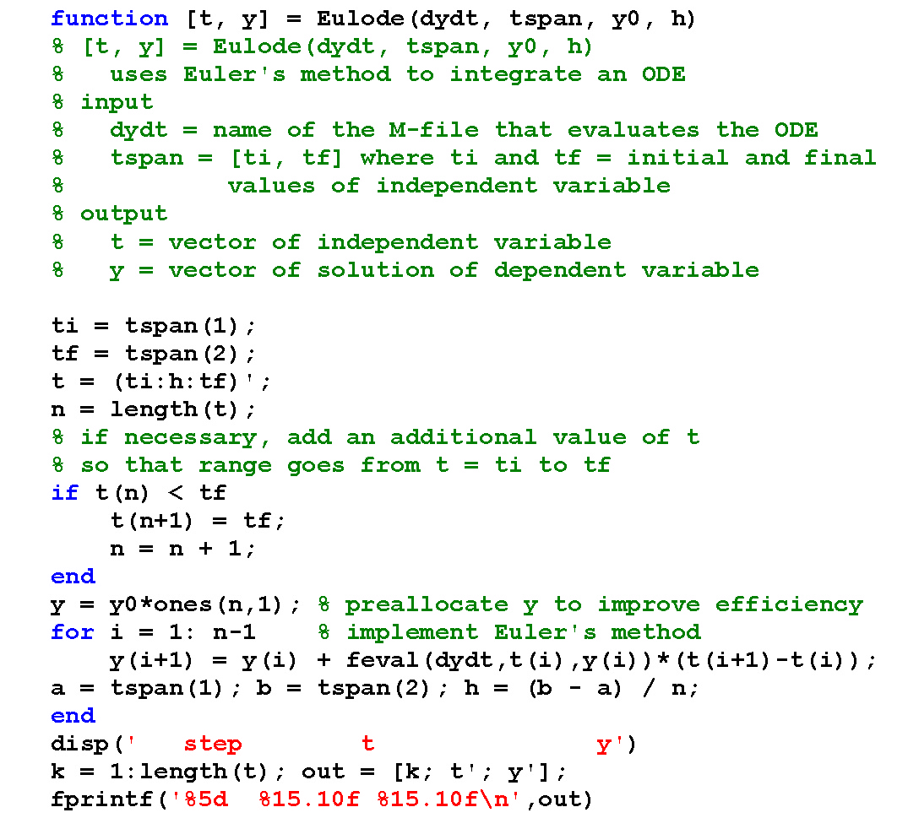
Another possible function
Euler’s Method

Slide 30
Truncation Errors
There are
Local truncation errors - error from application at a single step
Propagated truncation errors - previous errors carried forward
The sum is “global truncation error”

Slide 31
Local and Global Errors
Global error
Local error
y
y
y_{i+1}
y_{i+1}
y_{i}
y_{i}
o
x_{i}
x_{i+1}
x
o
x_{i+1}
x_{i+2}
x
x_{i}

Slide 32
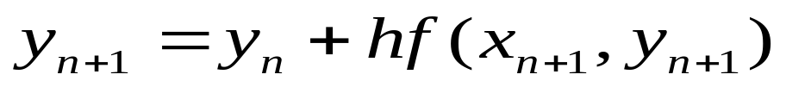
Implicit Euler’s Method
Procedure
Start from the given point
Calculate the next point using
Continue
Solve using nonlinear techniques.
Notice each time you continue the calculated point becomes the new starting point.

Slide 33
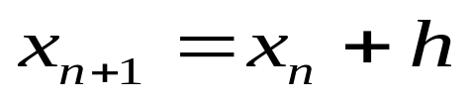
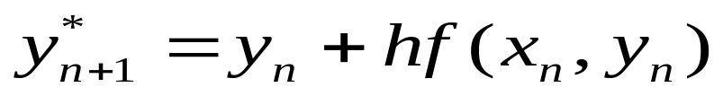
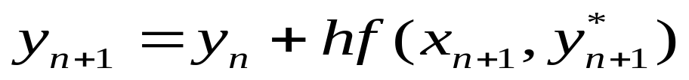
Implicit Euler’s Method
The above method is difficult to implement hence the need for modification.
Calculate the next point using
Predictor
Corrector
Continue
Notice each time you continue the calculated point becomes the new starting point.

Slide 34
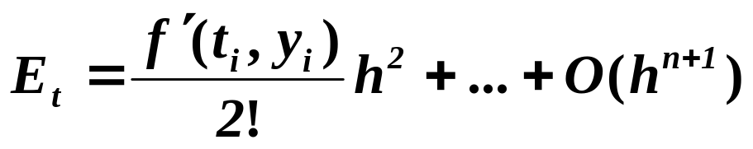

Taylor Series
Euler’s method uses Taylor series with only first order terms: Higher order methods are possible if we include more terms
The true local truncation error is
Approximate local truncation error - neglect higher order terms (for sufficiently small h)

